Slide 1
Full stack development

Slide 2
Types of Application
Desktop Application
Desktop applications are software programs run locally on computer devices. They aren’t accessible from a browser, like web-based apps, and require deployment on a personal computer or laptop.
Web Application
A web application (or web app) is application software that is accessed using a web browser. Web applications are delivered on the World Wide Web to users with an active network connection.

Slide 3
What is full stack development?
Full stack development is the end-to-end development of applications. It includes both the front end and back end of an application.
The front end is usually accessed by a client, and the back end forms the core of the application where all the business logic is applied.

Slide 4
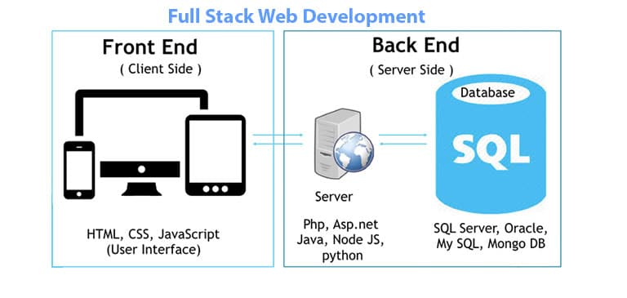
What includes in Full stack Development?

Slide 5
Front End (Web Design) Development?
Everything you see on a website, like buttons, links, animations, and more, were created by a front end web developer.
It is the front end developer's job to take the vision and design concept from the client and implement it through code.

Slide 6
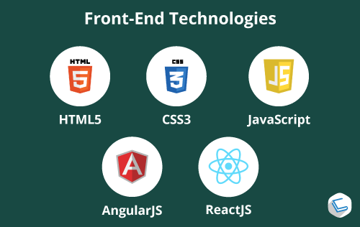
What Skills Do You Need to Become a Front End Development?
The three main languages you need to know well are HTML, CSS, and JavaScript.

Slide 7
What is Back end Development?
Back-end development means working on server-side software, which focuses on everything you can't see on a website.
Back-end developers ensure the website performs correctly, focusing on databases, back-end logic, application programming interface (APIs), architecture, and servers.

Slide 8
What Skills Do You Need to Become a Back End Developement?
Server side programming language
ASP.Net
Java
Python
PHP
Node JS
Database
The Oracle.
MySQL.
MS SQL Server.
PostgreSQL.
MongoDB.

Slide 9
What we are going to cover?
Front End Design
HTML
CSS
Javascript/Jquery
Bootstrap
React JS
Back End
Node JS
SQL/MySQL

Slide 10
HTML
HTML stands for Hyper Text Markup Language
HTML is the standard markup language for creating Web pages
HTML describes the structure of a Web page
HTML consists of a series of elements
HTML elements tell the browser how to display the content

Slide 11
Tools required for HTML code
Notepad
Notepad++
Sublime text
Visual Studio Code

Slide 12
A Simple HTML Document
<!DOCTYPE html>
<html>
<head>
<title>Page Title</title>
</head>
<body>
<h1>My First Heading</h1>
<p>My first paragraph.</p>
</body>
</html>

Slide 13
The <!DOCTYPE html> declaration defines that this document is an HTML5 document
The <html> element is the root element of an HTML page
The <head> element contains meta information about the HTML page
The <title> element specifies a title for the HTML page (which is shown in the browser's title bar or in the page's tab)
The <body> element defines the document's body, and is a container for all the visible contents, such as headings, paragraphs, images, hyperlinks, tables, lists, etc.
The <h1> element defines a large heading
The <p> element defines a paragraph

